Slide 1


VISVESVARAYA TECHNOLOGICAL UNIVERSITY
“JNANA SANGAMA”, BELAGAVI-590018
A MINI PROJECT REPORT ON
3D VENDING MACHINE
Submitted in partial fulfillment of the requirements For the award of degree of
Bachelor of Engineering
In
Computer Science and Engineering
By
SYED ZAINUL ABIDIN
[1KS19CS099]
Under guidance of
Mrs. GEETHA R
Asst. Prof, Dept. Of CSE
Mrs. KAVYA M S
Asst. Prof, Dept. Of CSE
Department of Computer Science & Engineering
K.S.INSTITUTE OF TECHNOLOGY,
#14, Raghuvanahalli, Kanakapura Main Road, Bengaluru-560109
2021-22

Slide 2
K.S.INSTITUTE OF TECHNOLOGY
#14, Raghuvanahalli, Kanakapura Main Road, Bengaluru-560109
Department of Computer Science & Engineering
CERTIFICATE
This is to certify that mini project work entitled “3D VENDING MACHINE” carried out by Mr. SYED ZAINUL ABIDIN bearing USN 1KS19CS099 bonafide student of K.S. Institute of Technology in the partial fulfilment for the award of the Bachelor of Engineering in Computer Science & Engineering of the Visvesvaraya Technological University, Belagavi, during the year 2021-22. It is certified that all corrections/suggestions indicated for Internal Assessment have been incorporated in the report deposited in the departmental library. The mini project report has been approved as it satisfies the academic requirements in respect of Mini Project work prescribed for the said degree for the 6th semester.
Dr. Rekha B. Venkatapur
Prof & HOD, CS & E Department
Dr. Dilip Kumar
Principal/Director, KSIT
Mrs.GEETHA R
Asst. Prof, Dept. Of CSE
Mrs.KAVYA M S
Asst. Prof, Dept. Of CSE
Name of the Examiner
1.
Signature with Date
2.

Slide 3
ACKNOWLEDGEMENT
I take this opportunity to thank one and all involved in building this project. Firstly I would like to thank the college for providing us an opportunity to work on the project.
I would also like to thank the management of K. S. Institute of Technology for providing all the resources required for the project.
I wish to acknowledge my sincere gratitude to our beloved Principal, Dr. Dilip Kumar for his encouragement and providing all facilities for the accomplishment of this project.
This project would not have been possible without the support of our beloved Prof & HOD, Dr. Rekha.B.Venkatapur, Dept. of CSE.
I am also highly grateful to my project guides, Mrs.Geetha R, Asst professor Dept. of CSE and Mrs.Kavya M S, Asst professor who have been very generous in assisting and supporting, to do this Project “3D VENDING MACHINE”.
I also would like to thank all other teaching and non-teaching staff members who have extended their support and co-operation while bringing up this project.
SYED ZAINUL ABIDIN (1KS19CS099)

Slide 4
ABSTRACT
Computer graphics is the process of making the design 2D, 3D And animate of an object. Computer graphics can do many things, including modeling, simulation and visualization of an object or a problem.
Modeling is a representation of how people describe or explain an object, system or a concept, which is usually manifested by simplification or idealization. This can be represented by physical models,model image or mathematical formulae.
OpenGL support this modeling capability as OpenGL has additional features to better produce something more realistic. OpenGL allows us to create a graph that can be run on any operating system with only minor adjustments.
A 3D Vending Machine simulator is developed in OpenGL using the library functions defined init. The graphics software system draws objects like Vending Machine, customer and also adds motion effects to them.

Slide 5
CONTENTS
1.INTRODUCTION
1.1
1.2
1.3
1.4
1.4.1
1.4.2
1.4.3
1.5
OVERVIEW 1-3
PROBLEM STATEMENT 4
COMPUTER GRAPHICS 5-8
OPEN GL 8-10
OPENGL GRAPHICS ARCHITECTURE 11 ADVANTAGES OF OPENGL 12
DRAWBACKS OF OPENGL 13 APPLICATIONS OF COMPUTER GRAPHICS 13
2. SYSTEM REQUIREMENTS
2.1
2.1.1
2.1.2
HARDWARE AND SOFTWARE REQUIREMENTS 14 SOFTWARE REQUIREMENTS 14
HARDWARE REQUIREMETS 15-17
3. SYSTEM ANALYSIS AND DESIGN
3.1
3.2
3.3
SYSTEM ANALYSIS SYSTEM DESIGN DATA FLOW DIAGRAM
18
18
19-20

Slide 6
IMPLEMENTATION
IMPLEMENTATION OF MODULES
21-24
5. TESTING AND SNAPSHOTS
25-27
CONCLUSIONS
28
REFERENCES
29
LIST OF FIGURES:
OPENGL GRAPHICS
DATA FLOW
OUTPUT 1

Slide 7
3D VENDING MACHINE
Chapter-1
INTRODUCTION
1.1 Computer Graphics
Computer graphics are graphics created using computers and the representation of image data by a computer specifically with help from specialized graphic hardware and software.
The interaction and understanding of computers and interpretation of data has been made easier because of computer graphics. Computer graphic development has had a significant impact on many types of media and have revolutionized animation, movies and the video game industry.
Computer graphics is widespread today. Computer imagery is found on television, in newspapers, for example in weather reports, or for example in all kinds of medical investigation and surgical procedures. A well-constructed graph can present complex statistics in a form that is easier to understand and interpret. In the media "such graphs are used to illustrate papers, reports, thesis", and other presentation material.
Computer generated imagery can be categorized into several different types: two dimensional (2D), three dimensional (3D), and animated graphics. As technology has improved, 3D computer graphics have become more common, but 2D computer graphics are still widely used. Computer graphics has emerged as a sub-field of computer science which studies methods for digitally synthesizing and manipulating visual content. Over the past decade, other specialized fields have been developed like information visualization, and scientific visualization more concerned with "the visualization of three dimensional phenomena (architectural, meteorological, medical, biological, etc.), where the emphasis is on realistic renderings of volumes, surfaces, illumination sources, and so forth, perhaps with a dynamic (time) component".
OpenGL Utility Toolkit (GLUT) was developed by Mark Kilgard, it Hides the complexities of differing window system APIs, Default user interface for class projects, Glut routines have prefix glut, Eg- glutCreateWindow().
DEPT OF CSE, KSIT
2021-22
Page7

Slide 8
3D VENDING MACHINE
1.2 OpenGL Technology
OpenGL is a graphics application programming interface (API) which was originally developed by Silicon Graphics. OpenGL is not in itself a programming language, like C++, but functions as an API which can be used as a software development tool for graphics applications. The term Open is significant in that OpenGL is operating system independent. GL refers to graphics language. OpenGL also contains a standard library referred to as the OpenGL Utilities (GLU). GLU contains routines for setting up viewing projection matrices and describing complex objects with line and polygon approximations.
OpenGL gives the programmer an interface with the graphics hardware. OpenGL is a low-level, widely supported modeling and rendering software package, available on all platforms. It can be used in a range of graphics applications, such as games, CAD design, modeling.
OpenGL is the core graphics rendering option for many 3D games, such as Quake 3. The providing of only low-level rendering routines is fully intentional because this gives the programmer a great control and flexibility in his applications. These routines can easily be used to build high-level rendering and modeling libraries. The OpenGL Utility Library (GLU) does exactly this, and is included in most OpenGL distributions! OpenGL was originally developed in 1992 by Silicon Graphics, Inc, (SGI) as a multi-purpose, platform independent graphics API. Since 1992 all of the development of OpenGL.
OpenGL is a software interface to graphics hardware. This interface consists of about 150 distinct commands that you use to specify the objects and operations needed to produce interactive three-dimensional applications.
OpenGL is designed as a streamlined, hardware-independent interface to be implemented on many different hardware platforms. To achieve these qualities, no commands for performing windowing tasks or obtaining user input are included in OpenGL; instead, you must work through whatever windowing system controls the particular hardware you’re using. The OpenGL
DEPT OF CSE, KSIT
2021-22
Page8

Slide 9
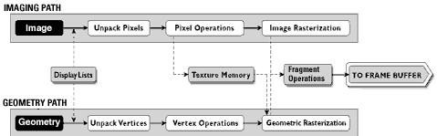
3D VENDING MACHINE
Visualization Programming Pipeline:
Figure. 1.1: OpenGl Visualization Programming Pipeline
OpenGL operates on image data as well as geometric primitives. Simplifies Software Development, Speeds Time-to-Market.
Routines simplify the development of graphics software—from rendering a simple geometric point, line, or filled polygon to the creation of the most complex lighted and texture mapped NURBS curved surface. OpenGL gives software developers access to geometric and image primitives, display lists, modeling transformations, lighting and texturing, anti-aliasing, blending, and many other features. Every conforming OpenGL implementation includes the full complement of OpenGL functions. The well-specified OpenGL standard has language bindings for C, C++, Fortran, Ada, and Java. All licensed OpenGL implementations come from a single specification and language binding document and are required to pass a set of conformance tests. Applications utilizing OpenGL functions are easily portable across a wide array of platforms for maximized programmer productivity and shorter time-to-market.
All elements of the OpenGL state—even the contents of the texture memory and the frame buffer—can be obtained by an OpenGL application. OpenGL also supports visualization applications with 2D images treated as types of primitives that can be manipulated just like 3D geometric objects. As shown in the OpenGL visualization programming pipeline diagram above.
DEPT OF CSE, KSIT
2021-22
Page9

Slide 10
3D VENDING MACHINE
1.3 PROJECT DESCRIPTION:
In this project we strive to obtain a 3-Dimensional Vending machine model. A vending machine is an automated machine that provides items such as snacks,beverages and lottery tickets to consume after the money is inserted into the machine.The first vending machine was developed in England in early 1880s that dispensed postcards.
The customer approaches the vending machine and selects the drink. After that the customer goes back.The movement of the customer is controlled by a variable “counter”. The variable is put into switch case to control the motion of the customer.
We make use of C with OpenGl for entire coding purpose along with some features of Windows. The OpenGl Utility is a Programming Interface. The toolkit supports much functionalities like multiple window rendering, callback event driven processing using sophisticated input devices etc.
DEPT OF CSE, KSIT
2021-22
Page10

Slide 11
3D VENDING MACHINE
OpenGl Functions Used:
This project is developed using CodeBlocks and this project is implemented by making extensive use of library functions offered by graphics package of OpenGl, a summary of those functions follows:
glBegin() :
Specifies the primitives that will be created from vertices presented between glBegin and subsequent glEnd.. GL_POLYGON, GL_LINE_LOOP etc.
glEnd(void) :
It ends the list of vertices.
glPushMatrix() :
voidglPushMatrix( void )
glPushMatrixpushes the current matrix stack down by one level, duplicating the current
matrix.
glPopMatrix() :
voidglPopMatrix(void )
glPopMatrixpops the top matrix off the stack, destroying the contents of the popped matrix.Initially, each of the stacks contains one matrix, an identity matrix.
glTranslate() :
voidglTranslate(GLdoublex, GLdoubley,GLdouble z )
Translation is an operation that displaces points by a fixed distance in a given direction. Parameters x, y, z specify the x, y, and z coordinates of a translation vector. Multiplies current matrix by a matrix that translates an object by the given x, y and z-values.
glClear() :
DEPT OF CSE, KSIT
2021-22
Page11

Slide 12
3D VENDING MACHINE
voidglClear(GLbitfield mask)
glClear takes a single argument that is the bitwise or of several values indicating which buffer is to be cleared. GL_COLOR_BUFFER_BIT, GL_DEPTH_BUFFER_BIT, GL_ACCUM_ BUFFER_BIT, and GL_STENCIL_BUFFER_BIT.Clears the specified buffers to their current clearing values.
glClearColor() :
voidglClearColor(GLclampf red, GLclampf green, GLclampf blue, GLclampf alpha)
Sets the current clearing color for use in clearing color buffers in RGBA mode. The red, green, blue, and alpha values are clamped if necessary to the range [0,1]. The default clearing color is (0, 0, 0, 0), which is black.
glMatrixMode() :
voidglMatrixMode(GLenum mode)
It accepts three values GL_MODELVIEW, GL_PROJECTION and GL_TEXTURE. It specifies which matrix is the current matrix. Subsequent transformation commands affect the specified matrix.
glutInitWindowPosition() :
voidglutInitWindowPosition(int x, int y);
This API will request the windows created to have an initial position. The arguments x, y indicate the location of a corner of the window, relative to the entire display.
glLoadIdentity() :
voidglLoadIdentity(void);
It replaces the current matrix with the identity matrix.
glutInitWindowSize() :
voidglutInitWindowSize(int width, int height);
DEPT OF CSE, KSIT
2021-22
Page12

Slide 13
3D VENDING MACHINE
The API requests windows created to have an initial size. The arguments width and height indicate the window’s size (in pixels). The initial window size and position are hints and may be overridden by other requests.
glutInitDisplayMode
void glutInitDisplayMode(unsigned int mode );
Specifies the display mode, normally the bitwise OR-ing of GLUT display mode bit masks.This API specifies a display mode (such as RGBA or color-index, or single or double- buffered) for windows.
glFlush() :
voidglFlush(void);
The glFlush function forces execution of OpenGL functions in finite time. 1.4.14glutCreateWindow() :
intglutCreateWindow(char *name);
The parameter name specifies any name for window and is enclosed in double quotes. This opens a window with the set characteristics like display mode, width, height, and so on.The string name will appear in the title bar of the window system. The value returned is a unique integer identifier for the window. This identifier can be used for controlling and rendering to multiple windows from the same application.
glutDisplayFunc() :
voidglutDisplayFunc(void (*func)(void))
Specifies the new display callback function. The API specifies the function that’s called whenever the contents of the window need to be redrawn. All the routines need to be redraw the scene are put in display callback function.
glColor3f
void glColor3f(GLfloat red, GLfloat green, GLfloat blue);
DEPT OF CSE, KSIT
2021-22
Page13

Slide 14
3D VENDING MACHINE
PARAMETERS:
1.
Red: The new red value for the current color.
2.
Green: The new green value for the current color.
3.
Blue: The new blue value for the current color.
Sets the current color.
glRotate():
voidglRotate( GLfloat angle, GLfloat x, GLfloat y, GLfloat z);
PARAMETERS:
angle: The angle of rotation, in degrees. x: The x coordinate of a vector.
y: The y coordinate of a vector. z: The z coordinate of a vector.
The glRotated and glRotatef functions multiply the current matrix by a rotation matrix.
glutInit():
glutInit(int *argcp, char **argv);
PARAMETERS:
argcp : A pointer to the program's unmodified argc variable from main. Upon return, the value pointed to by argcp will be updated, because glutInit extracts any command line options intended for the GLUT library.
argv : The program's unmodified argv variable from main. Like argcp, the data for argv will be updated because glutInit extracts any command line options understood by the GLUT library.
glutInit(&argc,argv);
glutInit is used to initialize the GLUT library.
DEPT OF CSE, KSIT
2021-22
Page14

Slide 15
3D VENDING MACHINE
1.4.19glutMainLoop(): voidglutMainLoop(void)
; glutMainLoop();
glutMainLoop enters the GLUT event processing loop. 1.4.20glEnable():
voidglEnable(GLenum cap); glEnable(GL_CULL_FACE);
PARAMETERS:
cap: A symbolic constant indicating an OpenGL capability. The glEnable enable OpenGL capabilities.
DEPT OF CSE, KSIT
2021-22
Page15

Slide 16
3D VENDING MACHINE
Chapter 2
LITERATURE SURVEY
People use the term “computer graphics” to mean different things in different context. Computer graphics are pictures that are generated by a computer. Everywhere you look today, you can find examples, especially in magazines and on television. Some images look so natural you can’t distinguish them from photographs of a real scene. Others have an artificial look, intended to achieve some visual effects.
There are several ways in which the graphics generated by the program can be delivered.
Frame- by- frame: A single frame can be drawn while the user waits.
Frame-by-frame under control of the user: A sequence of frames can be drawn, as in a corporate power point presentation; the user presses to move on to the next slide, but otherwise has no way of interacting with the slides
Animation: A sequence of frames proceeds at a particular rate while the user watches with delight.
Interactive program: An interactive graphics presentation is watched, where the user controls the flow from one frame to another using an input device such as a mouse or keyboard, in a manner that was unpredictable at the time the program was written. This can delight the eye.
2.1 History
OpenGL was developed by ‘Silicon Graphics Inc’ (SGI) on 1992 and is popular in the gaming industry where it competes with the Direct3D in the Microsoft Windows platform. OpenGL is broadly used in CAD (Computer Aided Design), virtual reality, scientific visualization, information visualization, flight simulation and video games development.
OpenGL is a standard specification that defines an API that is multi-language and
multi-platform and that enables the codification of applications that output computerized graphics in 2D and 3D.
DEPT OF CSE, KSIT
2021-22
Page16

Slide 17
3D VENDING MACHINE
The interface consists in more than 250 different functions, which can be used to draw complex tridimensional scenes with simple primitives. It consists of many functions that help to create a real world object and a particular existence for an object can be given.
Characteristics
OpenGL is a better documented API.
OpenGL is also a cleaner API and much easier to learn and program.
OpenGL has the best demonstrated 3D performance for any API.
Microsoft's Direct3D group is already planning a major API change called Direct
Primitive that will leave any existing investment in learning Direct3D immediate mode largely obsolete.
Computer Graphics Library Organization
OpenGL stands for Open Source Graphics Library. Graphics Library is a collection of APIs (Application Programming Interfaces).
Graphics Library functions are divided in three libraries. They are as follows-
GL Library (OpenGL in Windows)
GLU (OpenGL Utility Library)
GLUT ( OpenGL Utility Toolkit)
Functions in main GL library name function names that begin with the letter ‘gl’.
GLU library uses only GL functions but contains code for creating objects and simplify viewing.
To interface with the window system and to get input from external devices GLUT library is used, which is a combination of three libraries GLX for X windows, ‘wgl’ for Windows and ‘agl’ for Macintosh.
These libraries are included in the application program using preprocessor directives. E.g.: #include<GL/glut.h>
The following figure shows the library organization in OpenGL.
DEPT OF CSE, KSIT
2021-22
Page17

Slide 18
3D VENDING MACHINE
GLU
Open GL application
program
GL
Frame Buffer
GLUT
Xlib, Xtk
GLX
Fig 2.1 Library Organization
Graphics System and Functions
Graphics system and functions can be considered as a black box, a term used to denote a system whose properties are only described by its inputs and output without knowing the internal working.
Inputs to graphics system are functions calls from application program, measurements from input devices such as mouse and keyboard.
Outputs are primarily the graphics sent to output devices.
Application Program
Function calls
Graphics System
Output
Input Output Devices
Data
Input
Fig 2.2 Graphics System as a Black Box
API’s are described through functions in its library. These functions are divided into seven major groups.
DEPT OF CSE, KSIT
2021-22
Page18

Slide 19
3D VENDING MACHINE
Primitive Functions:
Primitive functions define the low level objects or atomic entities that a
system can display, the primitives include line segments, polygons, pixels, points, text and various types of curves and surfaces.
Attribute Functions:
Attribute Functions allow us to perform operations ranging from choosing the
color to display a line segment, to packing a pattern to fill inside any solid figure.
Viewing Functions:
Viewing functions allow us to specify various views.
Transformation Functions:
Transformation functions allow us to carry out transformation of objects such as rotation, translation and scaling.
Input Functions:
Input functions allow us to deal with the diverse forms of input that characterize modern graphics system. It deals with devices such as keyboard, mouse and data tablets.
Control Functions:
Control Functions enable us to communicate with the window system, to initialize the programs, and to deal with any errors that occur during the execution of the program.
Query Functions:
Query Functions provides information about the API.
DEPT OF CSE, KSIT
2021-22
Page19

Slide 20
3D VENDING MACHINE
Chapter-3
REQUIREMENTS SPECIFICATION
Hardware requirements:
Minimum of 2GB of main memory
Minimum of 3GB of storage
Mouse
Display Unit
Dual-Core or AMD with minimum of 1.5GHz speed
Software requirements:
Windows – XP/7/8
Microsoft Visual Studio C/C++ 7.0 and above versions
OpenGL Files
DirectX 8.0 and above versions
Header Files
glut.h
Object File Libraries
glut32.lib
DLL files
glut32.dll

Slide 21
3D VENDING MACHINE
Chapter-4
INTERFACE AND ARCHITECTURE
4.1 Flow Diagram
START
THE VENDING MACHINE
main
Depth test
reshape
Idle function
display
STOP
The flow diagram of 3D vending machine

Slide 22
3D VENDING MACHINE
OpenGL is a software tool for developing the graphics objects. OpenGL library called GLUT i.e. Graphics Library Utility toolkit supports graphics system with the necessary modelling and rendering techniques. The Lighting system is a technique for displaying graphic objects on the monitor and displaying the light effects. It provides the following functionalities.
Initialization
This function is the initial stage of the system where the system initializes the various aspects of the graphics system based on the user requirements, which include Command line processing, window system initialization and also the initial window creation state is controlled by these routines.
Event Processing
This routine enters GLUT’s event processing loop. This routine never returns, and it continuously calls GLUT callback as and when necessary. This can be achieved with the help of the callback registration functions. These routines register callbacks to be called by the GLUT event processing loop.

Slide 23
3D VENDING MACHINE
Chapter-4
IMPLEMENTATION
Source code: #include<stdio.h> #include <windows.h> #include <GL/glut.h> #include<math.h> #include <stdio.h> #include <stdlib.h>
GLfloat theta[]={0.0,0.0,0.0}; int counter=0;
double winHt=10.0; void HumanArm()
{
glPushMatrix();
glColor3f(0,0,1.0); glTranslated(0.6,0.66,0.3); glScaled(0.5,1.0,3.0); glutSolidSphere(0.15,50,50); glPopMatrix(); glPushMatrix(); glColor3f(0,0,1.0);
glTranslated(0.6,0.5,0.3);
glScaled(1.5,2.35,2); glutSolidCube(0.15); glPopMatrix(); glPushMatrix(); glColor3f(0.96,0.80,0.69);
glTranslated(0.6,0.33,0.3);

Slide 24
3D VENDING MACHINE
glScaled(1.5,1.0,3.0); glutSolidSphere(0.11,50,50); glPopMatrix(); glPushMatrix(); glColor3f(0.96,0.80,0.69);
glTranslated(0.6,0.2,0.4);
glScaled(1.5,2.35,2); glutSolidCube(0.15);
glPopMatrix(); glPushMatrix();
glColor3f(0.96,0.80,0.69);
glTranslated(0.6,0.0,0.5);
glScaled(1.5,1.0,3.0); glutSolidSphere(0.08,50,50); glPopMatrix();
}
void HumanLeg()
{
glPushMatrix(); glColor3f(0,0,1.0); glTranslated(0.6,0.66,0.3); glScaled(0.5,1.0,3.0); glutSolidSphere(0.15,50,50);
glPopMatrix(); glPushMatrix(); glColor3f(0.0,0.0,1.0);
glTranslated(0.6,0.5,0.3);
glScaled(2.0,2.35,2); glutSolidCube(0.15);
glPopMatrix();

Slide 25
3D VENDING MACHINE
glPushMatrix(); glColor3f(0,0,1.0); glTranslated(0.6,0.33,0.3); glScaled(2.0,1.0,3.0); glutSolidSphere(0.11,50,50); glPopMatrix(); glPushMatrix(); glColor3f(0,0,1.0);
glTranslated(0.6,0.2,0.4);
glScaled(2.0,2.35,2); glutSolidCube(0.15); glPopMatrix(); glPushMatrix(); glColor3f(0.0,0.0,0.0); glTranslated(0.6,0.01,0.7); glScaled(1.0,0.02,3.0); glutSolidCube(0.5); glPopMatrix();
}
void HumanBody()
{
glPushMatrix();
glColor3f(0,0,1.0); glTranslated(0,0.38,0); glScalef(3.0f,0.75f,2.0f); glutSolidCube(0.5); glPopMatrix(); glPushMatrix();
glColor3f(0,0,1.0);

Slide 26
3D VENDING MACHINE
glTranslated(-0.3,0.22,0); glRotated(120,0,0,1); glScalef(0.6f,0.5f,2.0f); glutSolidCube(0.5); glPopMatrix(); glPushMatrix(); glColor3f(0,0,1.0); glTranslated(0.3,0.22,0); glRotated(60,0,0,1); glScalef(0.6f,0.5f,2.0f); glutSolidCube(0.5); glPopMatrix(); glPushMatrix();//face glColor3f(0.96,0.80,0.69);
glRotatef(0, 0.0, 1.0, 0.0);
glTranslatef(0.0, 0.6, 0.0);
glScalef(1.5f, 1.0f, 1.2f);
glutSolidCube(0.5); glScalef(1.0f, 2.0f, 1.0f); glPopMatrix(); glPushMatrix();//left eye glColor3f(1.0, 1.0, 1.0);
glTranslated(1.0,1.1,5.0);
glScaled(0.3,0.19,0.2); glutSolidSphere (0.3, 20, 20); glPopMatrix(); glPushMatrix();
glColor3f(1.0, 1.0, 1.0); //right eye glTranslated(1.5,1.11,5.0);
glScaled(0.3,0.2,0.2);

Slide 27
3D VENDING MACHINE
glutSolidSphere (0.3, 20, 20); glPopMatrix(); glPushMatrix(); glColor3f(1.0,0,0); glTranslated(1.1,0.95,4.5); glRotated(100,1,0,0); glScaled(0.5,0.5,0); glutSolidCube(0.5); glPopMatrix(); glPushMatrix(); glColor3f(0,0,1.0);
glTranslated(0,-0.0,0);
glScalef(1.6f,0.8f,2.0f); glutSolidCube(0.5); glPopMatrix();
}
void drawHuman()
{
HumanBody(); glPushMatrix(); glTranslated(.2,-0.3,-0.2); HumanArm(); glPopMatrix();
glPushMatrix(); glTranslated(-1.4,-0.3,-0.2); HumanArm(); glPopMatrix(); glPushMatrix(); glTranslated(-0.2,-0.7,-0.4);
HumanLeg();

Slide 28
3D VENDING MACHINE
glPopMatrix(); glPushMatrix(); glTranslated(-1.0,-0.7,-0.4); HumanLeg(); glPopMatrix();
}
void drawHuman1()
{
HumanBody(); glPushMatrix();
glTranslated(.2,-0.3,-0.2); HumanArm(); glPopMatrix(); glPushMatrix(); glRotated(-60,1,0,0);
glTranslated(-1.4,-0.3,-0.2); HumanArm();
glPopMatrix(); glPushMatrix(); glTranslated(-0.2,-0.7,-0.4); HumanLeg(); glPopMatrix(); glPushMatrix();
glTranslated(-1.0,-0.7,-0.4);
HumanLeg(); glPopMatrix();
}
void initGL()
{
glClearColor(0.0f, 0.7f, 1.0f, 0.0f); // Set background color to black and opaque

Slide 29
3D VENDING MACHINE
glClearDepth(1.0f);
glShadeModel(GL_SMOOTH); // Set background depth to farthest glEnable(GL_DEPTH_TEST); // Enable depth testing for z-culling glDepthFunc(GL_LEQUAL); // Set the type of depth-test
glShadeModel(GL_SMOOTH); // Enable smooth shading glHint(GL_PERSPECTIVE_CORRECTION_HINT, GL_NICEST);
}
void drawbutton()
{
glPushMatrix();
glScaled(3,3,3); glutSolidCube(0.5); glPopMatrix(); glPushMatrix(); glScaled(2.5,2.5,3);
glTranslated(0.0,0.0,0.1); glutSolidCube(0.5);
glPopMatrix();
}
void dropper()
{
glPushMatrix();//roof glColor3f(0.196078,0.6,0.8);
glTranslated(0.0,1.5,0.60); glScaled(8,2,2); glutSolidCube(0.2); glPopMatrix(); glPushMatrix();//dispenser handle1
glColor3f(0.847059,0.847059,0.74902);
glTranslated(-0.5,0.8,0.5);
Page 23

Slide 30
3D VENDING MACHINE
glRotated(160,1,0,0); glScaled(0.35,2.35,0.35);
glutSolidCube(0.2); glPopMatrix();
glPushMatrix();//dispenser cube1 glColor3f(0.0,0.0,0.0);
glTranslated(-0.5,0.8,0.5);
glScaled(0.5,0.5,0.5);
glutSolidSphere(0.20,50,50); glPopMatrix();
glPushMatrix();//dispenser handle2 glColor3f(0.847059,0.847059,0.74902);
glTranslated(-0.1,0.8,0.5); glRotated(160,1,0,0); glScaled(0.35,2.35,0.35);
glutSolidCube(0.2); glPopMatrix();
glPushMatrix();//dispenser cube2 glColor3f(0.0,0.0,0.0);
glTranslated(-0.1,0.8,0.5);
glScaled(0.5,0.5,0.5); glutSolidSphere(0.20,50,50); glPopMatrix();
glPushMatrix();//dispenser handle3 glColor3f(0.847059,0.847059,0.74902);
glTranslated(0.3,0.8,0.5); glRotated(160,1,0,0); glScaled(0.35,2.35,0.35);
glutSolidCube(0.2); glPopMatrix();

Slide 31
3D VENDING MACHINE
glPushMatrix();//dispenser cube3 glColor3f(0.0,0.0,0.0);
glTranslated(0.3,0.8,0.5);
glScaled(0.5,0.5,0.5); glutSolidSphere(0.20,50,50); glPopMatrix();
}
void drawcoinpicker()
{ glColor3f(0.8,0.498039,0.196078);
glPushMatrix(); glTranslated(-0.1,-0.13,0.5);
glScaled(2.0,0.65,0.5); glutSolidCube(0.5); glPopMatrix();
glPushMatrix();
glTranslated(-0.1,0.3,0.5);
glScaled(2.0,0.65,0.5); glutSolidCube(0.5); glPopMatrix(); glPushMatrix(); glTranslated(-0.46,0.0,0.5);
glScaled(0.5,0.65,0.5); glutSolidCube(0.5); glPopMatrix(); glPushMatrix(); glTranslated(0.26,0.0,0.5); glScaled(.5,0.65,0.5);

Slide 32
3D VENDING MACHINE
glutSolidCube(0.5); glPopMatrix();
}
void drawcup()
{
glPushMatrix();//cup stand glTranslated(-0.1,-0.13,0.5);
glScaled(2.0,0.65,0.5);
glColor3f(0.85,0.85,0.85);
glutSolidCube(0.5); glPopMatrix(); glPushMatrix();//cup1 glColor3f(0.82,0.57,0.46);
glTranslated(-0.5,0.3,0.58); glRotated(90,1,0,0); glutSolidCone(.07,0.5,14,1);
glPopMatrix(); glPushMatrix();//cup2 glColor3f(1.0,1.0,0.0);
glTranslated(-0.1,0.3,0.58); glRotated(90,1,0,0); glutSolidCone(.07,0.5,14,1);
glPopMatrix();
glPushMatrix();//cup3 glColor3f(0.6,0.8,0.196078);
glTranslated(0.3,0.3,0.58); glRotated(90,1,0,0); glutSolidCone(.07,0.5,14,1);
glPopMatrix();

Slide 33
3D VENDING MACHINE
}
void drawcup1()
{
glPushMatrix();//cup stand glTranslated(-0.1,-0.13,0.5);
glScaled(2.0,0.65,0.5);
glColor3f(0.85,0.85,0.85);
glutSolidCube(0.5);
glPopMatrix(); glPushMatrix();//cup1
glColor3f(1.0,0.11,0.68);
glTranslated(-0.5,0.3,0.58); glRotated(90,1,0,0); glutSolidCone(.07,0.5,14,1); glPopMatrix(); glPushMatrix();//cup2 glColor3f(0.73,0.16,0.96);
glTranslated(-0.1,0.3,0.58); glRotated(90,1,0,0); glutSolidCone(.07,0.5,14,1); glPopMatrix(); glPushMatrix();//cup3 glColor3f(1.0,0.5,0); glTranslated(0.3,0.3,0.58); glRotated(90,1,0,0); glutSolidCone(.07,0.5,14,1); glPopMatrix();
}
void drawcup2()
{

Slide 34
3D VENDING MACHINE
glPushMatrix();//cup stand glTranslated(-0.1,-0.13,0.5);
glScaled(2.0,0.65,0.5);
glColor3f(0.85,0.85,0.85);
glutSolidCube(0.5); glPopMatrix(); glPushMatrix();//cup1 glColor3f(1.0,0.0,0.0);
glTranslated(-0.5,0.3,0.58); glRotated(90,1,0,0);
glutSolidCone(.07,0.5,14,1); glPopMatrix(); glPushMatrix();//cup2 glColor3f(0.0,0.0,1.0);
glTranslated(-0.1,0.3,0.58); glRotated(90,1,0,0); glutSolidCone(.07,0.5,14,1);
glPopMatrix(); glPushMatrix();//cup3 glColor3f(0.91,0.76,0.65);
glTranslated(0.3,0.3,0.58); glRotated(90,1,0,0); glutSolidCone(.07,0.5,14,1);
glPopMatrix();
}
void drawVmachine()
{
glPushMatrix();//body of vending machine glScaled(3,7,2);
glColor3f(0.137255,0.37255,0.55863);

Slide 35
3D VENDING MACHINE
glutSolidCube(0.5); glPopMatrix(); glPushMatrix();//button stand glScaled(3,3,2);
glTranslated(-0.00,-0.33,0.06); glColor3f(0.137255,0.37255,0.55863);
glutSolidCube(0.5); glPopMatrix();
glPushMatrix();//vmachine base glScaled(0.5,6,2);
glTranslated(1.2,-0.00,0.06); glColor3f(0.137255,0.37255,0.55863);
glutSolidCube(0.5); glPopMatrix(); glPushMatrix();//dropper roof glTranslated(-0.1,1.0,0.5);
glScaled(2.0,0.5,0.5);
glRotated(45,1,0,0); glColor3f(0.85,0.85,0.85);
glutSolidCube(0.5); glPopMatrix(); glPushMatrix();//button1 glColor3f(0.82,0.57,0.46);
glTranslated(0.6,1.0,0.5);
glScaled(0.15,0.15,0.2);
drawbutton(); glPopMatrix(); glPushMatrix();//button2 glTranslated(0.6,0.65,0.5);
glScaled(0.15,0.15,0.2);
Page 29

Slide 36
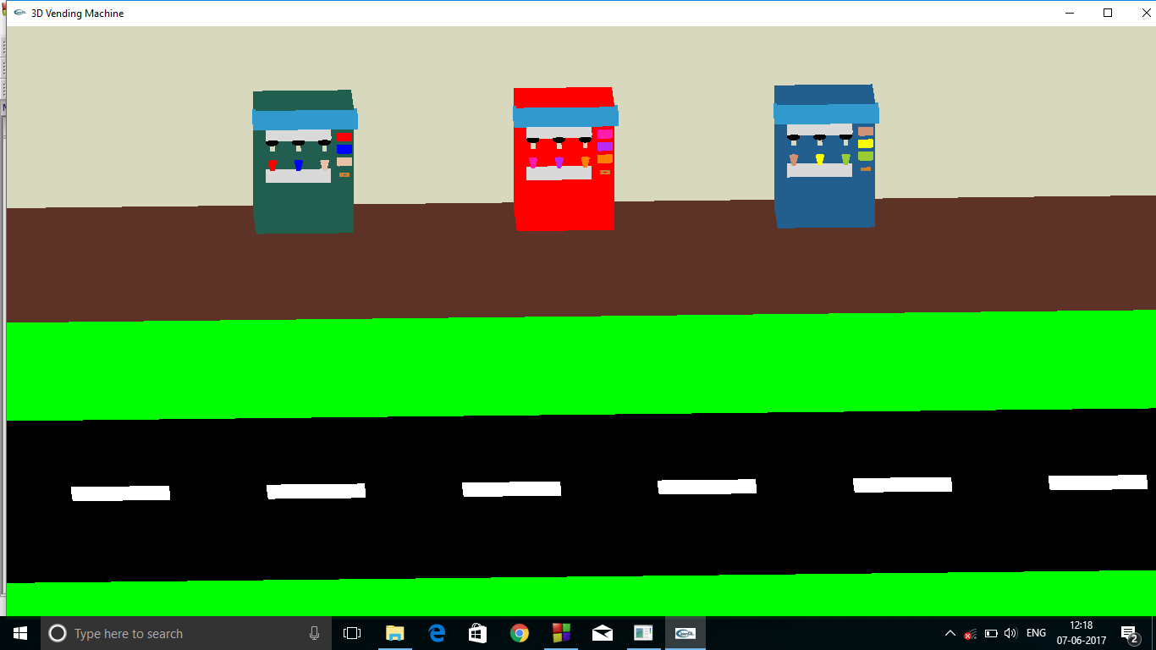
3D VENDING MACHINE
Chapter-5
SNAPSHOTS
Snapshot 1: First scene

Slide 37
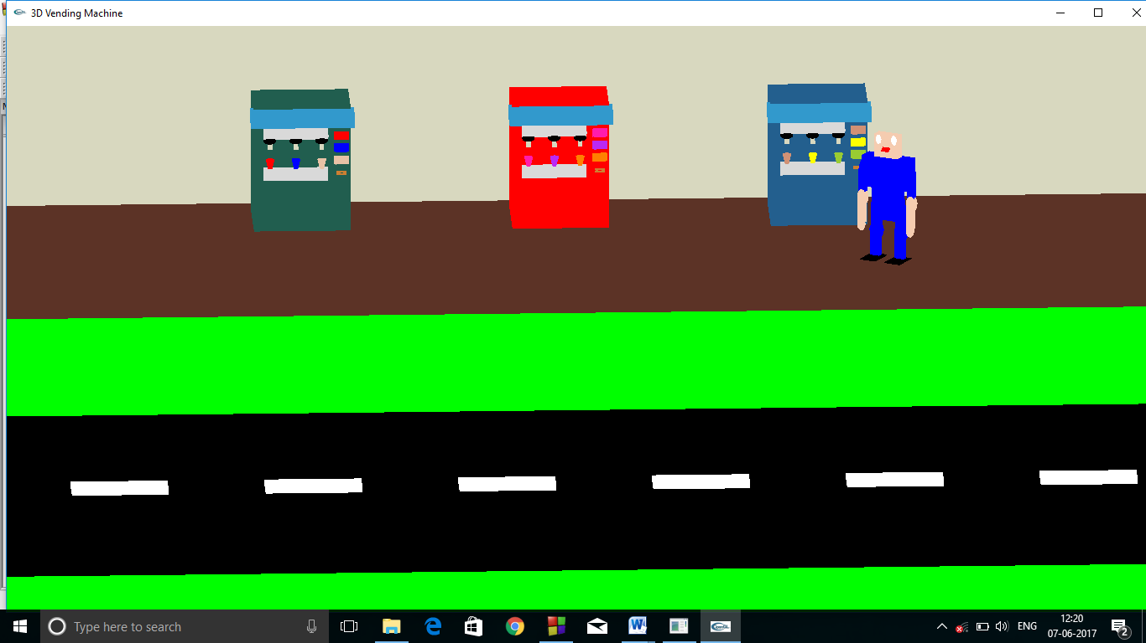
3D VENDING MACHINE
Snapshot 2: Customer entering the scene

Slide 38
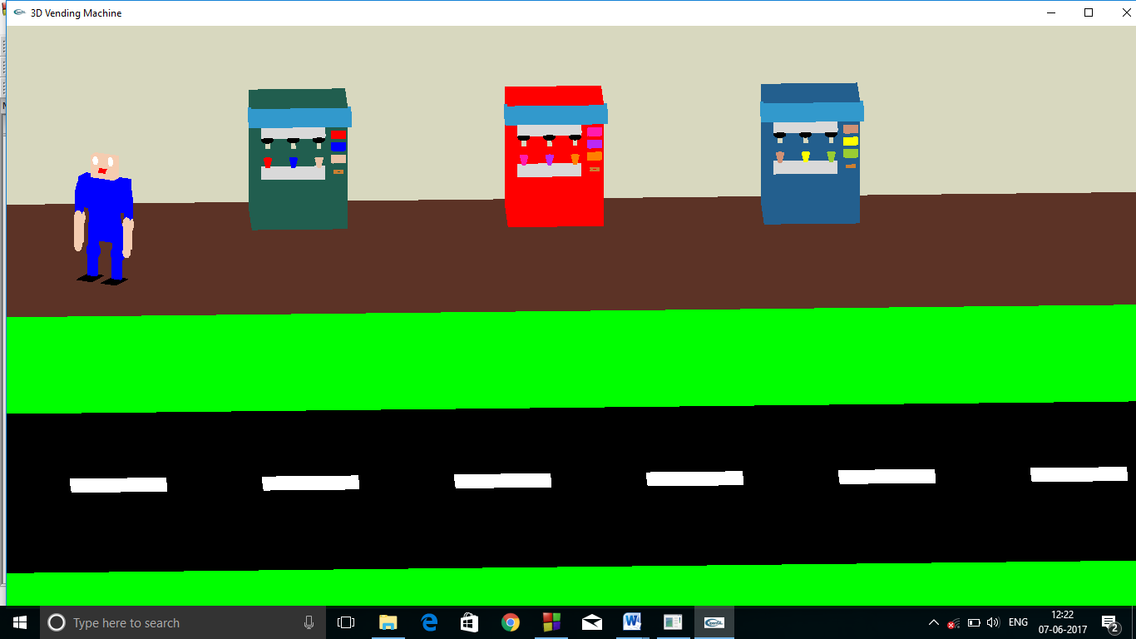
3D VENDING MACHINE
Snapshot 3: Customer leaving the scene

Slide 39
3D VENDING MACHINE
Chapter-6
CONCLUSION & FUTURE ENHANCEMENT
A 3D Vending Machine simulator is developed in OpenGL using the library functions defined init. The graphics software system draws objects like Vending Machine, customer and also adds motion effects to them.
By user’s point of view, the OpenGL software is very easy to use. Also it is the most widely used application in interactivity. The designers developed the GLUT toolkit which provides all the functionalities that is expected on virtual systems, which allows for the portability of the system to work in a variety of environments. Using which we can develop the physically based models such as particle system etc.
In future:
The vending machine can be made manual and user-friendly instead of being static.

Slide 40
3D VENDING MACHINE
REFERENCE
[1] Interactive Computer Graphics-Edward Angel [2]Fundamentals of Computer Graphics -Peter Shirley Sites Referred
www.computergraphics.com
en.wikipedia.org/wiki/OpenGL
www.opengl.com

